Slide 1



The Effect of Higher Protein Dosing in Critically Ill Patients:
The EFFORT Trial
A Multicenter, Volunteer-driven, Registry-based Randomized Trial
Daren K. Heyland
Professor of Medicine
Queens University, Kingston General Hospital
Kingston, ON Canada

Slide 2

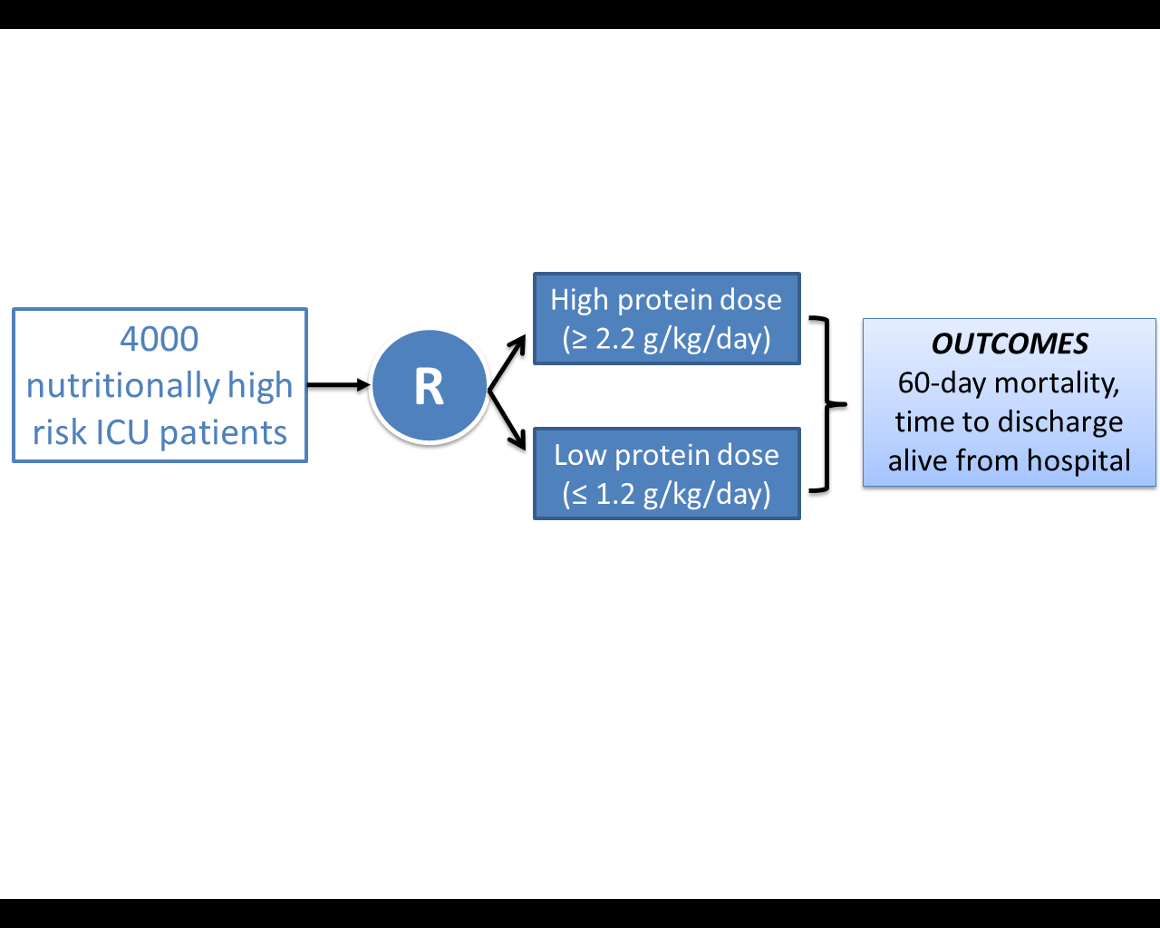
The Effect of Higher Protein Dosing
in Critically Ill Patients:
The EFFORT Trial
Target >2.2 gram/kg/day
Primary Outcome
4000 ICU patients
R
Stratified by:
Site
BMI
Med vs Surg
Fed enterally
60 day
mortality
Target <1.2 gram/kg/day
A multicentre, pragmatic, volunteer-driven, registry-based, randomized, clinical trial.
74 patients randomized to date
Notes:
.use this slide to explain learning objectives- recruit you to the trial and in the context, explain current science of protein adminstraiton and details of trial.

Slide 3

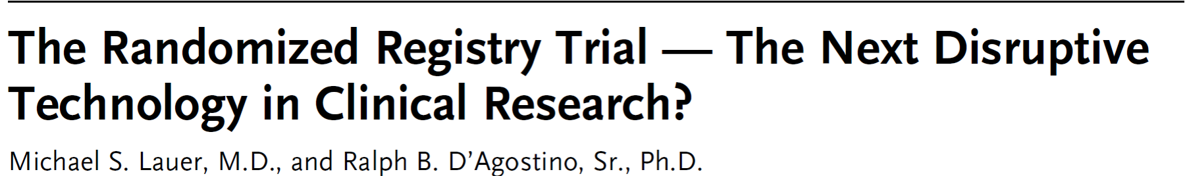
Clinical registries are established tools for auditing clinical standards and benchmarking QI initiatives
Data from clinical registries can be used to formulate hypothesis
With appropriate methods, make causal inferences (albeit weaker inference)
Results more generalizable
NEJM 369;17:1579

Slide 4
Randomized patients undergoing angioplasty to manual thrombus aspiration or usual care.
Used existing national cardiac registries
Over 7000 patients were efficiently recruited from the registry to evaluate the study question and aside from the randomized intervention, the trial imposed no other study procedures and all data were collected by existing registries supported by funds from national or other hospital sources.
Total incremental cost 300,000 Euros; 50 Euros/patient enrolled!
Am Heart J 2010:160:1042 and NEJM 2013;369:1587

Slide 5
Registry-based Randomized Clinical Trials (RRCT)
A possible solution?
Recent experience with large scale, multi-center, observational studies conducted by volunteers in hundreds of ICUs around the world opens the possibility of using the same International Nutrition Survey (INS) infrastructure to support large scale, randomized trials.
The creation of registry-based, volunteer supported, large-scale, randomized clinical trials related to critical care clinical nutrition

Slide 6


Participation Across the 5 Years of the Survey : 708 Distinct ICUs
Canada: 95
USA: 225
Europe and Africa: 109
UK: 37
Turkey: 11
Ireland: 12
Italy: 9
Norway: 8
South Africa: 13
Switzerland: 4
Spain: 4
Slovenia:1
Sweden: 3
Czech Republic:3
Austria:2
Portugal:1
France:1
Asia: 145
Colombia:19
Brazil:10
Argentina:7
Uruguay:5
Mexico: 3
Chile:3
Venezuela:2
Peru:1
Paraguay:1
El Salvador:1
Puerto Rico:1
China: 38
Japan: 43
India: 36
Taiwan:5
Singapore: 11
Saudi Arabia:2
Philippines:2
Iran : 2
Thailand: 2
UAE:1
Malaysia:2
Indonesia:1
Latin America: 53
Australia: 73 New Zealand: 8

Slide 7
Value of Bench-marked Site Reports
Recommendations: Based on 8 level 2 studies, we recommend early enteral nutrition (within 24-48 hrs following resuscitation) in critically ill patients.
Early vs Delayed Nutrition Intake

Slide 8
The Effect of Higher Protein Dosing
in Critically Ill Patients:
The EFFORT Trial
Target >2.2 gram/kg/day
Primary Outcome
4000 ICU patients
R
Stratified by:
Site
BMI
Med vs Surg
Fed enterally
60 day
mortality
Target <1.2 gram/kg/day
A multicentre, pragmatic, volunteer-driven, registry-based, randomized, clinical trial.
Notes:
.

Slide 9
Overall Hypothesis
Compared to the receiving lower dose of prescribed protein, the prescription of a higher dose of protein/amino acids to nutritionally high-risk critically ill patients will be associated with greater amount of protein delivered and result in improved survival and a quicker rate of recovery.

Slide 10

Does Clinical Equipoise Exist?

Slide 11
What dose do you routinely prescribe
to the ‘average’ ICU patient?
< 1.0 gram/kg/d
1.1 – 1.5 gram/kg/d
1.6 – 2.0 gram/kg/d
> 2.1 gram/kg/d

Slide 12
Note: Wide range of acceptability and
Low quality of evidence!

Slide 13
Results of 2014 INS
In 2014 INS, on average, patients were prescribed 1.3 grams/kg/day (interquartile range, 1.0-1.5 grams/kg/day,
overall range, 0.5-3.8 grams/kg/day).

Slide 14
Does increasing protein delivery impact outcomes?

Slide 15
What happens to exogenously administered
amino acid?
Olav Rooyakers CC. icu-metabolism.se

Slide 16
Effect on Nitrogen Balance?
249 trauma patients receiving nutrition support
Dickerson J Trauma Acute Care Surg 2012

Slide 17
What is the evidence that exogenously administered amino acids/protein favorably impacts muscle mass and function?
RCT of 119 ICU patients requiring PN
Randomized to 0.8 gram/kg/day vs. 1.2 grams/kg/day IV aa
Ferrie JPEN 2016

Slide 18
What is the evidence that exogenously administered amino acids/protein favorably impacts muscle mass and function?
No impact on LOS or mortality
Ferrie JPEN 2016

Slide 19
What is the evidence that exogenously administered amino acids/protein favorably impacts muscle mass and function?
Pilot RCT of Volume-based feeds and protein supplements vs. standard nutrition
60 patients
Adjusted for baseline QMLT, greater protein intake was associated with less QMLT loss at discharge with a mean attenuated loss of 0.22 cm (95% CI, 0.06–0.38; P = .01), controlling for patient age severity of illness (APACHE III score), BMI, and admission diagnosis
No change in LOS or mortality or muscle function
Fetterplace JPEN 2018

Slide 20
Impact on Clinical Outcomes: RCT Level of Evidence?
The Nephroprotect Study
RCT short-term daily IV aa on kidney function in critical illness, compared to standard care.
Unblinded
All patients expected to remain 48 hrs; excluded patients with AKI
Max protein intake total of 2.0 gm/kg/day (IBW)
More patient in Intervention group with:
  Higher APACHE II severity of illness scores (20.2 ± 6.8 vs. 21.7 ± 7.6, P = 0.02)
  pre-existing renal dysfunction (29/235 vs. 44/239, P = 0.07)
Doig Int Care Med 2015

Slide 21
The Nephroprotect Study
Doig Int Care Med 2015

Slide 22
The Nephroprotect Study
P=0.004
No difference in any other renal or clinical outcome
No impact on survival or HRQOL
Doig Int Care Med 2015

Slide 23
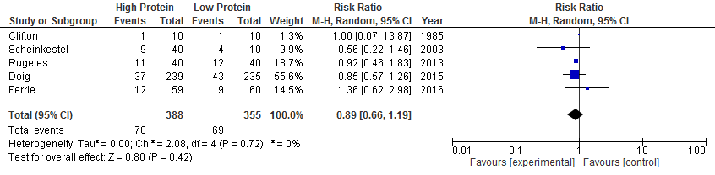
Systematic Review of RCTs of
High vs. Low Dose Protein

Slide 24
What is the evidence that exogenously administered amino acids/protein favorably impacts clinical outcomes?

Slide 25
Impact of Protein Intake on 60-day Mortality
Data from 2828 patients from 2013 International Nutrition Survey
 | Patients in ICU ≥ 4 d
Variable | 60-Day Mortality, Odds Ratio (95% CI)
 |  | Adjusted¹ | Adjusted²
Protein Intake (Delivery > 80% of prescribed vs. < 80%) |  | 0.61 (0.47, 0.818) | 0.66 (0.50, 0.88)
Energy Intake (Delivery > 80% vs. < 80% of Prescribed) |  | 0.71 (0.56, 0.89) | 0.88 (0.70, 1.11)
¹ Adjusted for BMI, Gender, Admission Type, Age, Evaluable Days, APACHE II Score, SOFA Score
² Adjusted for all in model 1 plus for calories and protein
Nicolo JPEN 2015

Slide 26
Rate of Mortality Relative to
Adequacy of Protein and Energy Intake Delivered
TIACOS ICM 2011
INTACT JPEN 2014
Current practice
0.7 gm/kg
Minimally acceptable
1.2 gm/kg
Ideal practice?
>1.5 gm/kg
Heyland JPEN 2015

Slide 27
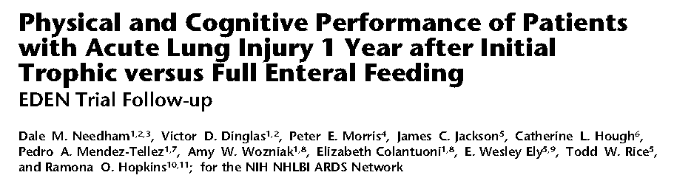
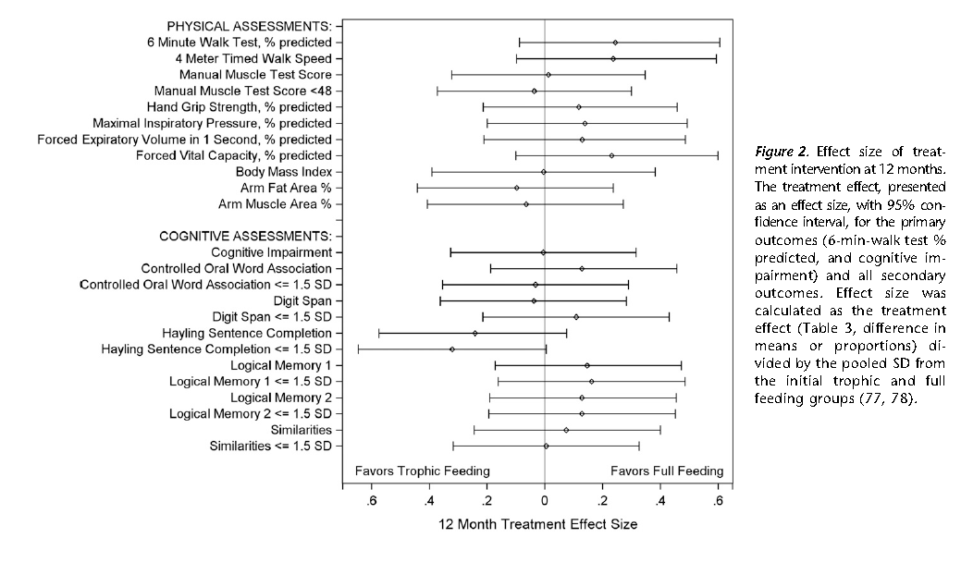

Slide 28
Nutritional Adequacy and Long-term Outcomes in Critically Ill Patients Requiring Prolonged Mechanical Ventilation
Sub study of the REDOXS study
302 patients survived to 6-months follow-up and were mechanically ventilated for more than eight days in the intensive care unit were included.
Nutritional adequacy was obtained from the average proportion of prescribed calories received during the first eight days of mechanical ventilation in the ICU.
HRQoL was prospectively assessed using Short-Form 36 Health Survey (SF-36) questionnaire at three-months and six-months post ICU admission.
Wei CCM 2015

Slide 29
Estimates of association between nutritional adequacy and SF-36 scores
*Every 25% increase in nutritional adequacy; adjusted for age, APACHE II score, baseline SOFA, Functional Comorbidity Index, admission category, primary ICU diagnosis, body mass index, and region

Slide 30
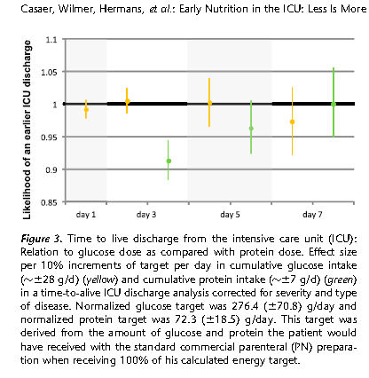
Post-hoc analysis of EPANIC
Indication bias:
1) patients with longer projected stay would have been fed more aggressively; hence more protein/calories is associated with longer lengths of stay.
2) 90% of these patients are elective surgery. There would have been little effort to feed them and they would have categorically different outcomes than the longer stay patients in which their were efforts to feed
3) PN didn’t start till day 3, so all the signal was from small amounts of EN?
Protein is the bad guy!!
Casaer Am J Respir Crit Care Med 2013;187:247–255

Slide 31
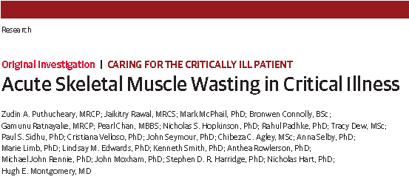
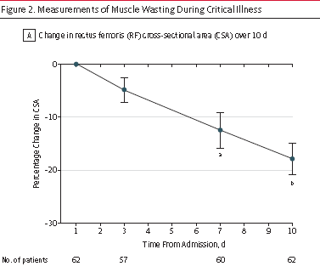
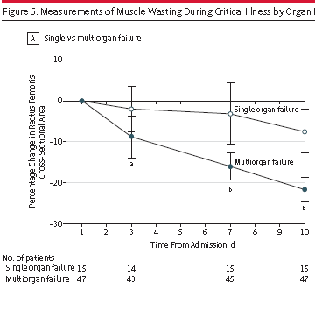
JAMA Published online Oct 9, 2013

Slide 32
“In a multivariable linear analysis, change in rectus femoris CSA was positively associated with the degree of organ failure, CRP level and amount of protein delivered”
JAMA Published online Oct 9, 2013

Slide 33
78 patient with ALI randomized to Intensive Medical therapy (30 kcal/kg/day) or usual care (40-60% of target)
Stopped early because of excess deaths in intensive group
Post hoc analysis suggests increased death from early protein!

Slide 34

RCTs do not suggest any evidence of harm and observational studies suggest increased protein intake associated with…
Reduced mortality¹
Quicker Time-to-discharge-alive¹
Greater preservation of muscle ^{2,3}
Reduced infection ⁴
Increased mortality⁵
Slower time-to-discharge-alive from ICU⁶
Greater loss of muscle mass⁷
1 Nicolo JPEN 2015
5 Braunschweig Am J Clin Nutr 2017
2 Ferrie JPEN 2016
6 Casaer Am J Respir Crit Care Med 2013
3 Fetterplace JPEN 2018
7 Puthucheary JAMA 2013
4 Heyland JPEN 2010

Slide 35
RCTs do not suggest any evidence of harm and observational studies suggest increased protein intake associated with…
Reduced mortality¹
Quicker Time-to-discharge-alive¹
Greater preservation of muscle ^{2,3}
Reduced infection ⁴
Increased mortality⁵
Slower time-to-discharge-alive from ICU⁶
Greater loss of muscle mass⁷
5 Braunschweig Am J Clin Nutr 2017
1 Nicolo JPEN 2015
6 Casaer Am J Respir Crit Care Med 2013
2 Ferrie JPEN 2016
7 Puthucheary JAMA 2013
3 Fetterplace JPEN 2018
4 Heyland JPEN 2010

Slide 36
You have to have clinical equipoise (uncertainty) to be able to participate in this trial!
Notes:
Alfonso, if this NIBBLE translated into Spanish? If so, please put a snap shot of the Spanish version and web link

Slide 37
Is there enough uncertainty that practitioners will be comfortable with their patients being randomized to ‘low dose’ group? to the high group? if not, don’t enroll!
What is the effect of prescribing a higher dose (>2.2 grams/kg/day) of protein/amino acid administration compared to a low group prescribed <1.2 gram/kg/day on 60 day mortality?

Slide 38
Intervention
Eligible patients will be randomized to one of 2 groups:
  High dose group: Patients will be prescribed >2.2 g/kg/day
  Low dose group: Patients will be prescribed <1.2 g/kg/day
BOTH groups
  Use dry pre-ICU body weight
  Use IBW based on a BMI of 25, if BMI >30
  Achieve goals through any combination of enteral and parental sources (as needed).
  The only difference between the 2 groups are the protein targets that are set.
  Success defined as achieving at least 80% of protein targets

Slide 39
Intervention
We encourage participating clinicians to be conservative in meeting energy targets and avoid overfeeding.
Energy prescription and intake should be the same between the 2 groups
For non-obese patients, we suggest that their caloric prescription be around 20-25 kcal/kg/day using a simple weight based formula.
  If the site chooses to use more sophisticated equations or indirect calorimetry, that is permissible.
  Its really important to avoid overfeeding defined as >110% of prescribed amounts
For obese patients, if indirect calorimetry is used, the goal of the nutritional prescription should be to provide energy not to exceed 65%–70% of measured requirements.
  If indirect calorimetry is unavailable or not used, we suggest using the weight-based equation 11–14 kcal/kg actual body weight per day for patients with BMI in the range of 30–50 and 22–25 kcal/kg ideal body weight per day for patients with BMI >50.

Slide 40
FAQ re: Intervention
“How do I achieve the higher doses of protein? Is their a particularly product or strategy you are recommending?”
ANS: No. this is a pragmatic trial in which the only thing that you are constrained to do is prescribe a high or usual amount of protein. There is prescribed way achieve the high protein intake. You can use all products, protocols and strategies available to you.
Note: you should get involved in this trial if you don’t have products or protocols that guarantee that you can achieve near goal in the high group.
Notes:
Alfonso, I made some formatting changes and added the question from the next slide, which was the same question. I added some words to the answer.

Slide 41
Use of High Protein Containing Enteral Solutions
Van Zanten Crit Care 2018

Slide 42
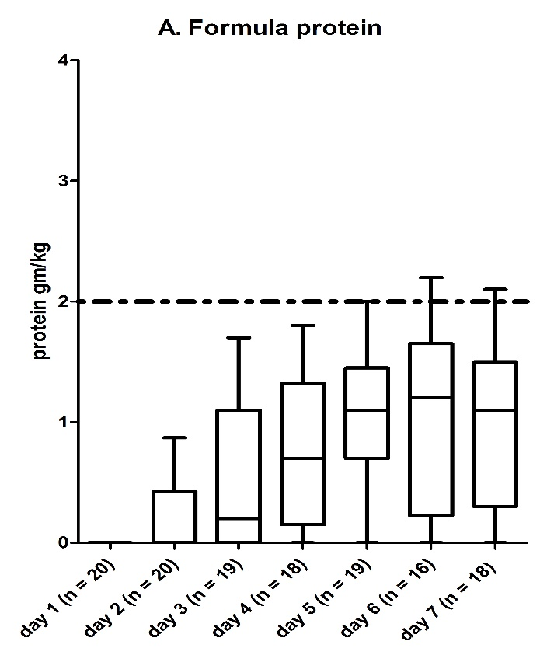
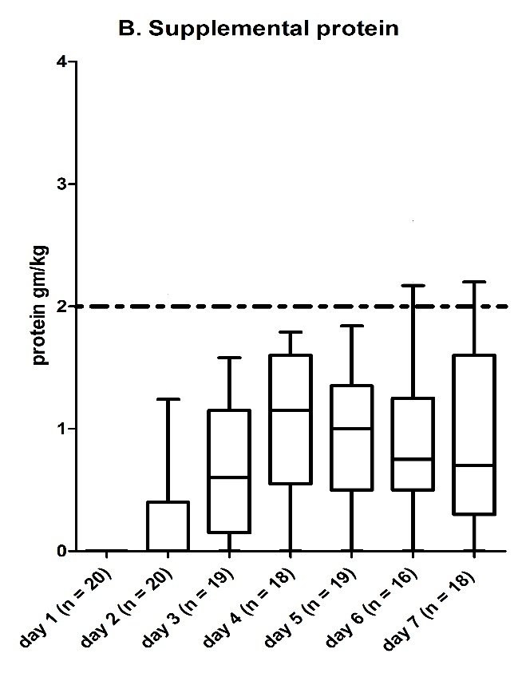
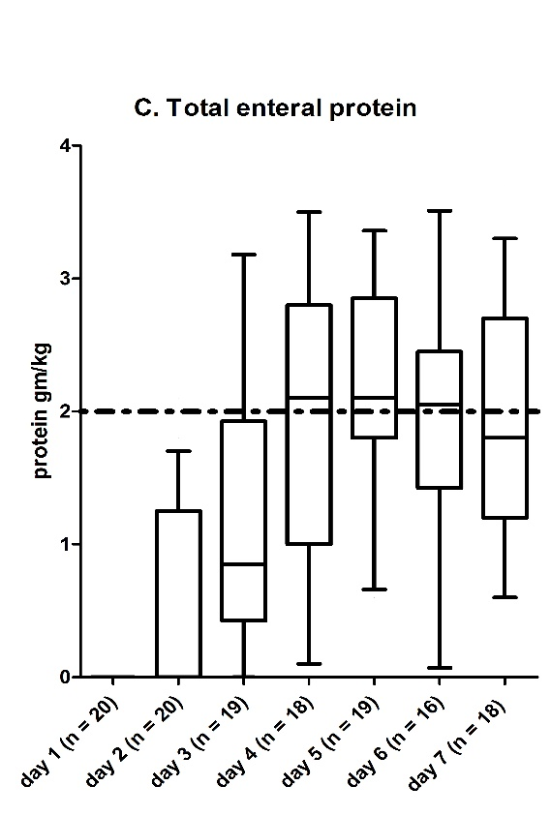
Effect of Protein Supplements q6h to a dose of 1-.1.5 gm/kg/day
Heyland NCP 2017

Slide 43
Results of Supplemental PN in Nutritionally High-risk ICU patients: The TOP UP Study
 | EN (n=71) | EN+PN (n=49) | Difference mean (95% CI) | p-value
Adequacy by EN route only
Calories first 27 days | 70±26 | 67±25 | -3 (-12 to 7) | 0.55
Calories first week | 68±28 | 68±27 | -1 (-11 to 9) | 0.91
Protein first 27 days | 66±26 | 60±23 | -5 (-14 to 3) | 0.23
Protein in first week | 63±26 | 61±25 | -3 (-12 to 7) | 0.57
Adequacy by EN or PN route
Calories first 27 days | 72±25 | 90±16 | 18 (11 to 25) | <.001
Calories first week | 69±28 | 95±13 | 26 (18 to 34) | <.001
Protein first 27 days | 68±25 | 82±19 | 13 (6 to 21) | <.001
Protein in first week | 64±26 | 86±16 | 22 (14 to 29) | <.001
Wischmeyer CC 2017

Slide 44
The Nephroprotect Study:
RCT Of IV Amino Acid Top Up strategy
No difference in clinical outcomes but safe to do
Doig ICM 2015

Slide 45
Study Population
MUST focus on ‘high nutritional risk’ patients.
One or more of the below risk factors:
  NUTRIC >5
  Low (≤ 25) and High BMI (≥ 35)
  Mod-Severe Malnutrition* (as diagnosed by local standards)
  Frailty (Clinical Frailty Scale 5 or more)
  Sarcopenic- (SARC-F score of 4 or more)
  Projected duration of mechanical ventilation >4 days
Difficult to collect ‘real-time’; will collect data and do subgroup analysis
*We will document the means by which sites are making this determination and capture the elements of the assessment (history of weight loss, history of reduced oral intake, etc.).

Slide 46
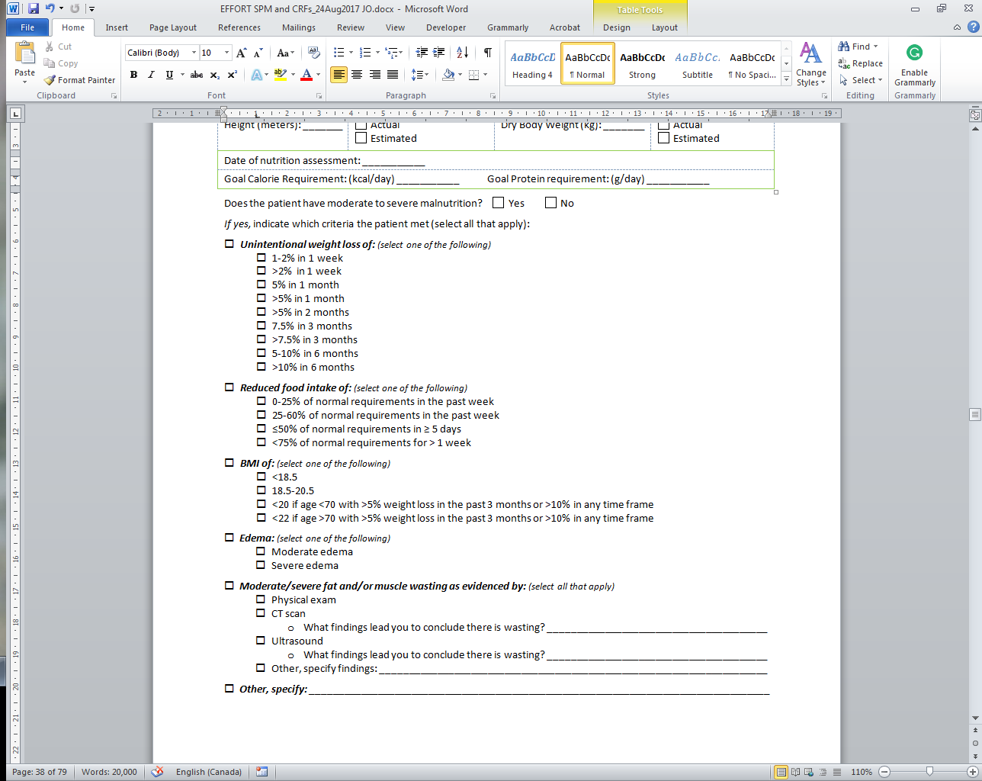
Criteria used to define Mod-Severe Malnutrition

Slide 47
Skeletal Muscle is Related to Mortality in Critical Illness
Presence of low muscularity associated with decreased ventilator-free days (P=0.004) and ICU-free days (0.002)
BMI, fat and serum albumin were not associated with ventilator- and ICU-free days
P=0.018
Moisey LL et al. Crit Care. 2013;17(5):R206.

Slide 48
How to Measure Sarcopenia?
Imaging techniques not currently practical or validated in ICU patients
Use SARC-F score questionnaire
Score of 4 or more as entry criteria
Malmstrom JAMDA 2013;531-32

Slide 49
Sarcopenic patients may benefit more from Early EN
Retrospective analysis of 254 septic patients
Fed early (within 48 hrs) vs. delayed (after 48 hrs)
Categorized as sarcopenic vs. non sarcopenic using CT scan of L3
Koga JCC 2018;47:153-158

Slide 50
Relationship between Sarcopenia and Frailty
Mueller N et al. Ann Surg. 2016;264(6):1116-1124.

Slide 51
Clinical Frailty Scale
Easier to operationalize
Predicts for poor outcome in ICU patients, particularly the elderly
May identify a subgroup of ‘high-risk’ patients that benefit from more nutrition?
Bagshaw CMAJ 2014;186;E95

Slide 52
Study Population
Inclusion Criteria | Exclusion Criteria | Rationale for Exclusion
1. >18 years old 2. Nutritionally “high-risk” (meeting one of the below criteria) Low (<25) or High BMI (>35) Moderate to severe malnutrition (as defined by local assessments) Frailty (Clinical Frailty Scale, 5 or more from proxy) Sarcopenia – (SARC-F score of 4 or more from proxy) From point of screening, projected duration of mechanical ventilation >4 days) 3. Requiring mechanical ventilation with actual or expected total duration of mechanical ventilation >48 hours | >96 continuous hours of mechanical ventilation before screening | Intervention is likely most effective when delivered early
 | 2. Expected death or withdrawal of life-sustaining treatments within 7 days from screening | Patients unlikely to receive benefit
 | 3. Pregnant | Unknown effects on fetus
 | 4. The responsible clinician feels that the patient either needs low or high protein | Uncertainty doesn’t exist; patient safety issues
 | 5. Patient requires parenteral nutrition only and site does not have products to reach the high protein dose group. | Site will be unable to reach high protein dose prescription.

Slide 53
FAQ re: Study Population
“What is the recommended dose for patients with renal failure receiving RRT?”
“Protein prescription in amounts of ≤ 1.2/kg/day is not rational in some groups of patients such as polytrauma, massive surgery and some burns. Will patients with higher protein needs be excluded from the study?”
ANS: There is no RCT level of evidence to support this guideline assertion and with the mounting evidence that protein may be harmful and suppress autophagy, we lack certainty that this is the right thing to do. We wish all these patients to be included in the RCT and plan an a priori specified subgroup analysis to evaluate the effect of protein dose on outcome in these specific subgroups.
Notes:
Alfonso, I made some formatting changes and added the question from the next slide, which was the same question. I added some words to the answer.

Slide 54
Consideration of Special Study Populations
All 2014 patients (n= 3936) | Prescribed 1.3 grams/kg/day (interquartile range, 1.0-1.5 grams/kg/day) | Overall range, 0.5-3.8 grams/kg/day
Age >80 (n=413) | Prescribed 1.2 grams/kg/day (interquartile range, 1.0-1.4 grams/kg/day) | Overall range, 0.6-2.5 grams/kg/day
Burn Patients (n=303) | Prescribed 1.8 grams/kg/day (interquartile range, 1.4-2.2 grams/kg/day) | Overall range, 0.6-3.8 grams/kg/day
Trauma Patients (n=385) | Prescribed 1.4 grams/kg/day (interquartile range, 1.1-1.6 grams/kg/day) | Overall range, 0.6-3.0 grams/kg/day
Obese patient with a BMI >30 (n=969) | Patients were prescribed 1.1 grams/kg/day (interquartile range, 0.8-1.2 grams/kg/day) | Overall range, 0.5-3.3 grams/kg/day
We would propose to include them but if clinician not comfortable, can exclude.

Slide 55
Subgroup Analyses
Age (based on median)
Severity of illness (based on median APACHE II)
Case Mix
  Sepsis
  Burns
  Trauma
  AKI and/or RRT at baseline
Malnutrition risk factors, both individually and combinations
Wounds
Others?

Slide 56
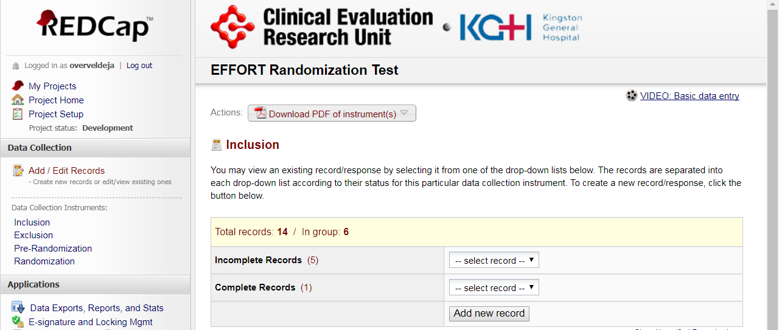
Randomizing a Participant using REDCap

Slide 57
Data Collection
(Similar to INS in the past only less data)
Patient demographics
  Age, Sex, comorbidities
  Admission type and diagnosis
  APACHE II, SOFA
Nutritional Assessment
  Weight, height
  Malnutrition, frailty, SARC-F
  Goals
Nutrition Processes of Care
  Timing and use of EN, PN, supplements, propofol (not IV glucose)
  Adequacy of protein and energy
Labs
Glucose, renal function, phosphate

Slide 58
Outcomes
Limited outcomes collected in INS
  Nutritional adequacy
  Persistent Organ Dysfunction PODS)
    Use of vasopressors, RRT, ventilation
  Duration of mechanical ventilation
  Duration of ICU and Hospital stay
  Hospital mortality
  60-day mortality
  Readmissions to ICU and Hospital within 60 days of enrollment
  Discharge status
  Time to discharge alive from hospital
Addition of performance-based measures via sub-studies?
  Hand grip strength? 6 MWD? 4ms?
  Questionnaires asking ADLs/QOL at 3 and/or 6 months?

Slide 59
Statistical Considerations
Large pragmatic trial with little effort to restrict participation of sites and patients nor standardize co-interventions will increase noise
Aim to have power to detect smaller treatment effects which will increase sample size requirements
Need 4000 patients!
Final analysis will be intention-to-treat

Slide 60
Ethical Issues
Obtaining informed consent will also be a barrier.
Waiver of informed consent possible? (Yes, for 2 sites in the USA so far)
Minimal Risk?
  Has been so far for INS (de-identifiable data)
  Addition of randomization factor for usual care interventions does not change the risk and require informed consent (IMHO)
Impractical?
  Without funding, would be impractical to use research resources to consent families (we are relying on clinicians volunteering on their own time to recruit eligible patients).
Plan to work with some sites to ‘test the waters’ to see if we can get a waiver and just provide information letter to families/SDM
If not, have ICF ready to go but puts extra burden on the site.

Slide 61
Waiver of Consent?
Waiver of consent granted in >50% of ICUS

Slide 62
Setting
ICUs from around the world will voluntarily participate and be screened for suitability.
What will be our criteria for suitability?
  Participants must be knowledgeable about critical care nutrition (submit their CV or other documentation);
  Have Good Clinical Practice (or similar) training (submit their training certificate);
  Confirm their site has overall equipoise and is willing to abide by the randomization schema and not overfeed patients;
  Confirm they use some form of a standardized feeding protocol (specific nature of the protocol not important);
  Confirm they have access to a range of commercial products (high protein enteral nutrition, protein supplements, and parenteral nutrition or amino acids);
  Have obtained ethics approval.
  Provide an electronic signature that they will be committed to enrolling a minimum of 30 eligible patients in 2-3 years.

Slide 63
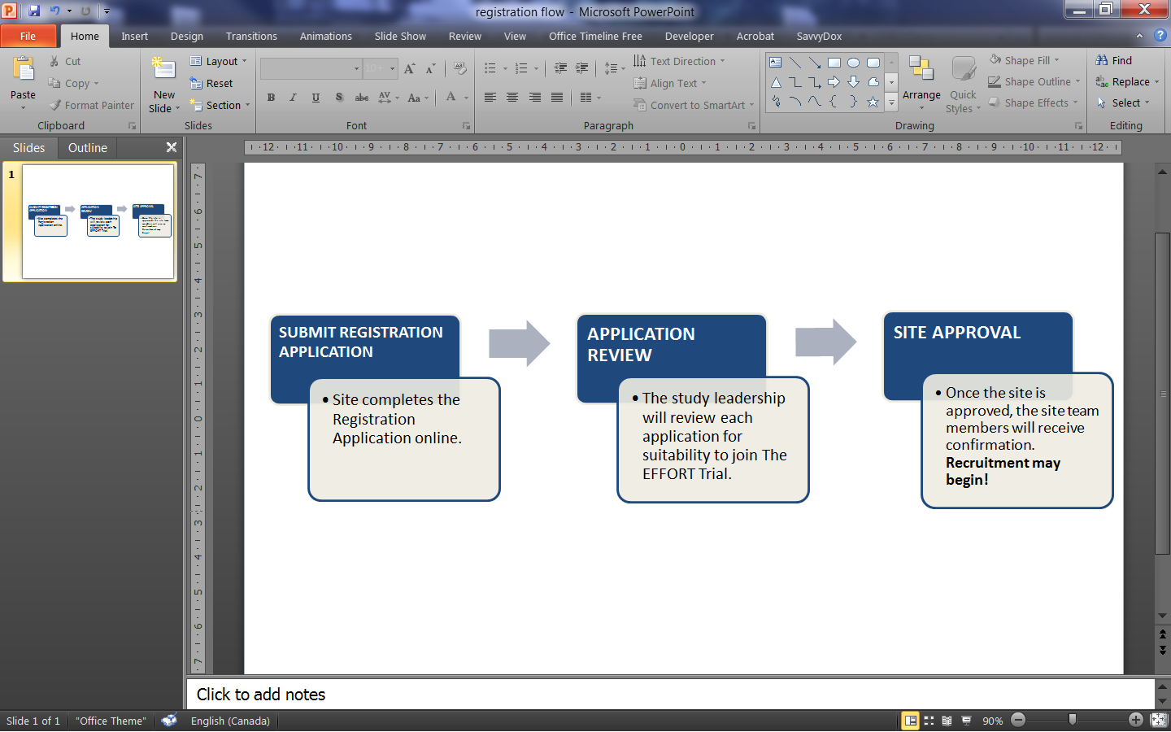
Site Registration Process

Slide 64
Notes:
Daren I thought this could follow the overall site status to indicate what sites potential might be coming on board. With these sites hoping to see increase in enrollment???
DKH: Ok, good idea. Can you put the total number of sites on the slide?

Slide 65
Next Steps
Protocol finalized- all documents on web.
Registration has commenced, please get started for your institution!
  Vanderbilt - USA
  University of Pennsylvania - USA
  London Health Sciences Centre/CTO – Canada
  Hospital Maisonneuve Rosemont- Quebec
  Republica Dominicana
  Argentina
  Oklahoma State University
66 patients enrolled
Many sites around the world in start up phase
REB submitted at U of A
Plan to develop sub-studies at meeting Oct 19th in association with Western Canada Nutrition Day in Edmonton

Slide 66
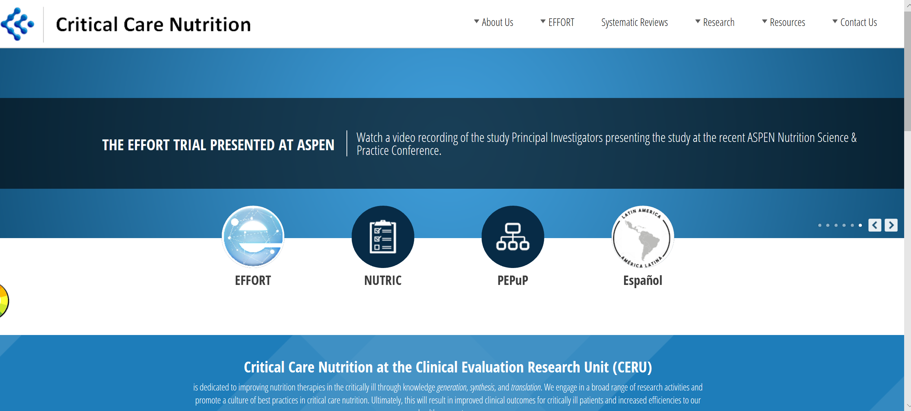
Please take the poll on how user friendly the website is for EFFORT

Slide 67
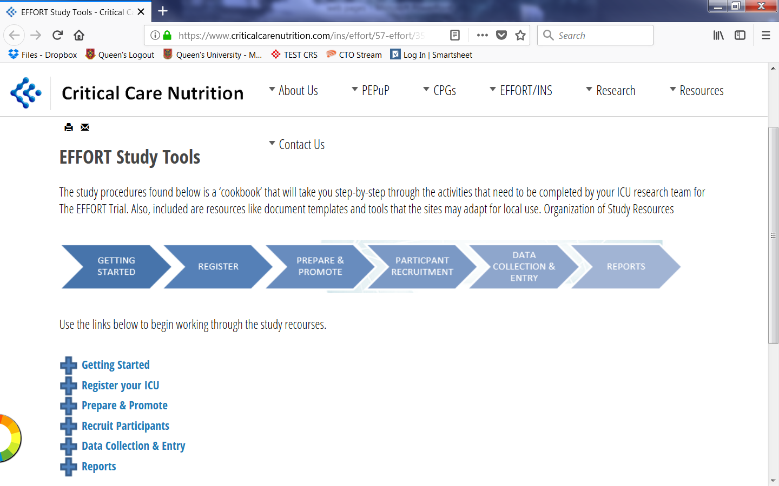

Slide 68
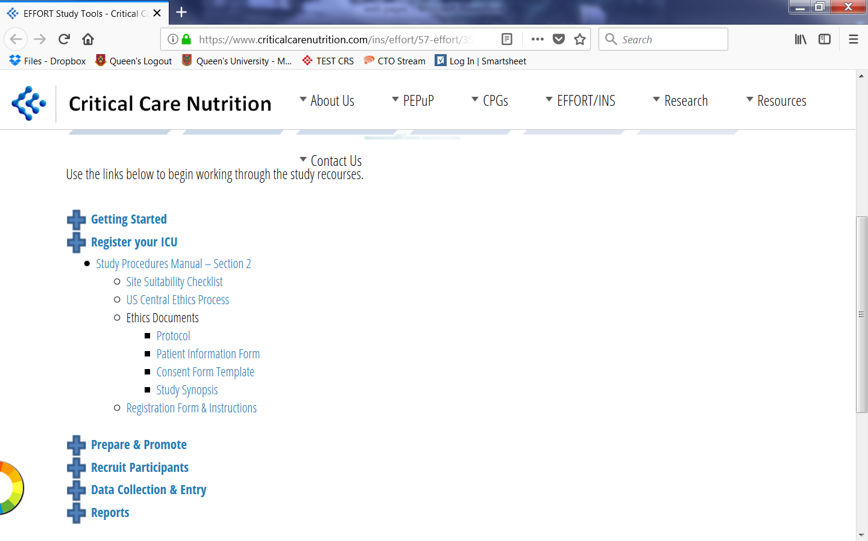

Slide 69

Thank YOU for your interest and support
I can not do what you can do.
You cannot do what I can do.
Together, we can do great things!
-Mother Theresa
For more information
See www.criticalcarenutrition.com or contact: Daren Heyland dkh2@queensu.ca

Slide 70
Questions?

